Slide 1
Data Structures and Algorithms -3 (25CS2103E)
Title of the project
Team Members
Name: Ratna Priya
Under the Esteemed Guidance of
Name of the DSA-3 faculty name with designation and department

Slide 2
Contents
Abstract
Introduction
Literature survey
Problem Statement and Objectives
Hardware and Software requirements
Results
Conclusion
Future Scope

Slide 3
Abstract
The Seat Selection System for Bus, Flight and Train is a data-structure-based application designed to manage seat availability and selection efficiently. Traditional seat booking systems may become difficult to manage when multiple seats, passengers and different types of transportation are involved. This project provides an interactive system where users can view available seats, select their preferred seats, and confirm bookings . The system uses appropriate data structures and algorithms to represent the seating arrangement, maintain seat availability, perform searching and updating operations, and manage booking information. Arrays, linked lists, queues and searching techniques can be used according to the requirements of different modules. The system aims to provide faster seat management, reduce duplicate bookings and improve the overall booking experience.

Slide 4
Introduction
Seat booking is an important part of transportation management systems.
Users need to identify available seats quickly.
Manual seat management can result in:
Duplicate bookings
Incorrect seat availability
Slow searching
Difficult booking management
Data Structures help organize and access booking information efficiently.
Our system provides a common seat-selection approach for:
🚌 Bus
✈️ Flight
🚆 Train

Slide 5
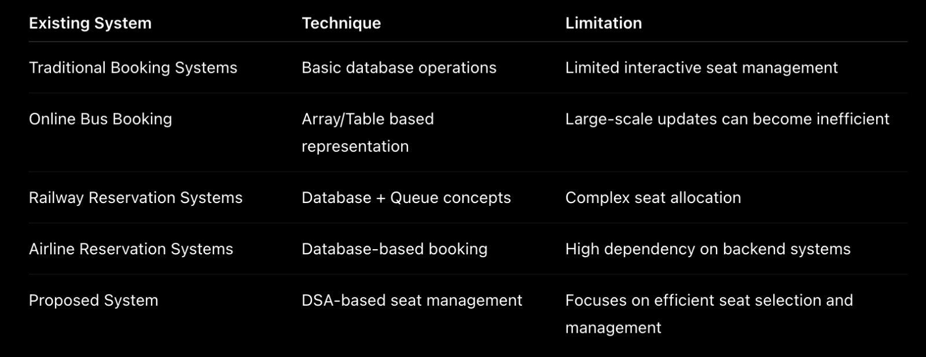
Literature Survey

Slide 6
Problem Statement and Objectives
Problem
Transportation booking systems need to efficiently manage a large number of seats while preventing duplicate bookings and providing quick access to seat information.
Existing Problems
Difficult seat management
Duplicate seat selection
Slow searching in large seat lists
Inefficient updating of seat status
Different seating arrangements for different transportation modes
Proposed Solution
Develop a DSA-based Seat Selection System that efficiently manages seat availability, selection and booking.
Main Objectives
To develop an efficient seat selection system.
To represent different seating arrangements using suitable data structures.
To provide quick seat searching and availability checking.
To update seat status after selection/booking.
To prevent duplicate seat bookings.
To manage booking information efficiently.
To apply DSA concepts to a real-world problem.

Slide 7
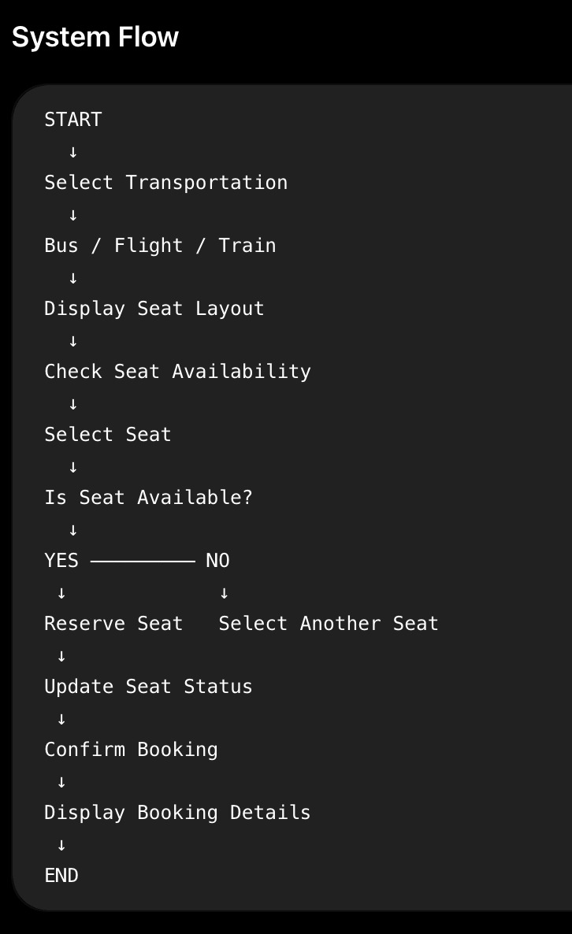
Flow Chart

Slide 8
Results
Expected ResultsThe proposed system successfully provides:Efficient seat representationQuick seat availability checkingSimple seat selectionPrevention of duplicate bookingsBooking cancellationAutomatic seat-status updatesOrganized booking informationExampleBefore Booking:
[ A ][ A ][ B ][ A ]After selecting Seat 2:[ A ][ S ][ B ][ A ]After confirmation:[ A ][ B ][ B ][ A ]A = AvailableS = SelectedB = Booked

Slide 9
Hardware and Software requirements
Hardware
Computer/Laptop
Minimum 4 GB RAM
Keyboard and Mouse
Basic processor
Software
Operating System: Windows/Linux
Programming Language: C / C++ / Java (use whichever you're actually implementing)
IDE: VS Code / CodeBlocks / IntelliJ
Browser – for web interface, if applicable
DSA Concepts
Arrays
Linked Lists
Queues
Searching
Sorting
Insertion & Deletion

Slide 10
Conclusion
The Seat Selection System for Bus, Flight and Train demonstrates how Data Structures and Algorithms can be applied to solve a real-world transportation booking problem.
The system provides efficient seat management by using appropriate data structures for storing, searching, updating and managing booking information. It reduces the possibility of duplicate bookings and provides a simple and organized method for seat selection.
The project also demonstrates the practical importance of DSA concepts in real-world applications

Slide 11
Future Scope
Online payment integration
Real-time seat availability
User authentication
Database integration
Mobile application
AI-based seat recommendation
Real-time bus/train/flight integration
Advanced booking analytics
Graph-based route optimization
Cloud-based booking system
Thomas H. Cormen et al., Introduction to Algorithms
Mark Allen Weiss, Data Structures and Algorithm Analysis
Data Structures and Algorithms course materials
Research papers related to reservation and seat allocation systems

Slide 12
Thank you

